Slide 1
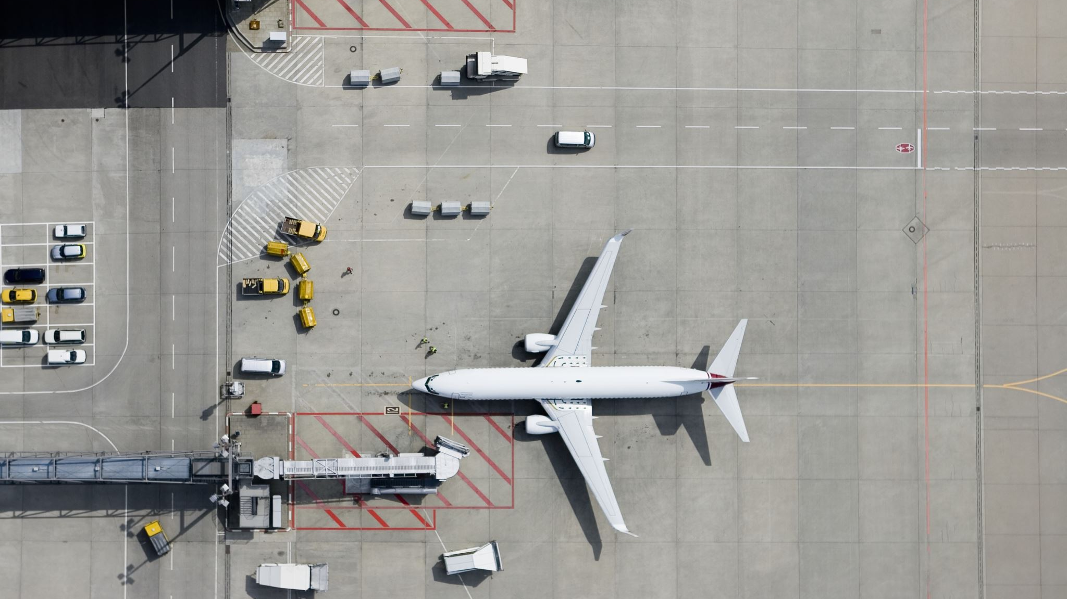

King Fahd International Airport
Khalifa Shoaib
BSAvM-01
2520247

Slide 2
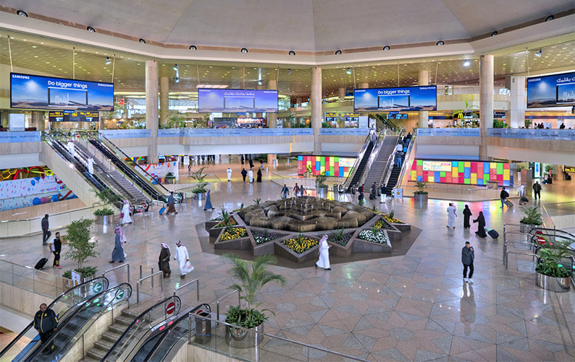
Introduction
King Fahd International Airport (KFIA)
King Fahd International Airport is one of the most important and advanced airports in Saudi Arabia.
It is located in Dammam, the capital of the Eastern Province.
The airport also serves nearby major cities such as Dhahran, Al Khobar, and Jubail.
KFIA is famous worldwide for being the largest airport by land area, covering 780 square kilometers of desert land.
It offers modern facilities, efficient services, and world-class infrastructure for travelers.
The airport plays a key role in connecting Saudi Arabia to international destinations, helping to grow tourism, trade, and business.

Slide 3

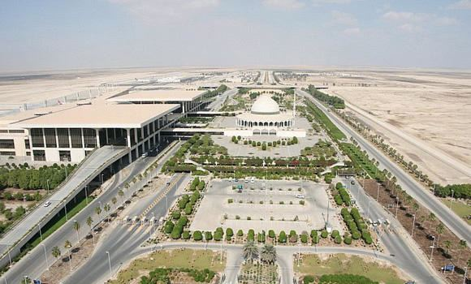
History and Development
The idea for King Fahd International Airport (KFIA) began in the early 1980s when air traffic in the Eastern Province started to grow rapidly.
Construction work officially started in 1983, led by the Saudi Ministry of Defense and Aviation.
The airport was built to replace Dhahran International Airport, which was becoming too small for the region’s needs.
KFIA was officially opened for commercial operations in November 1999.
Since its opening, it has become a symbol of Saudi Arabia’s modernization and progress in the aviation sector.
Continuous upgrades and expansions keep the airport in line with international standards and passenger expectations.

Slide 4
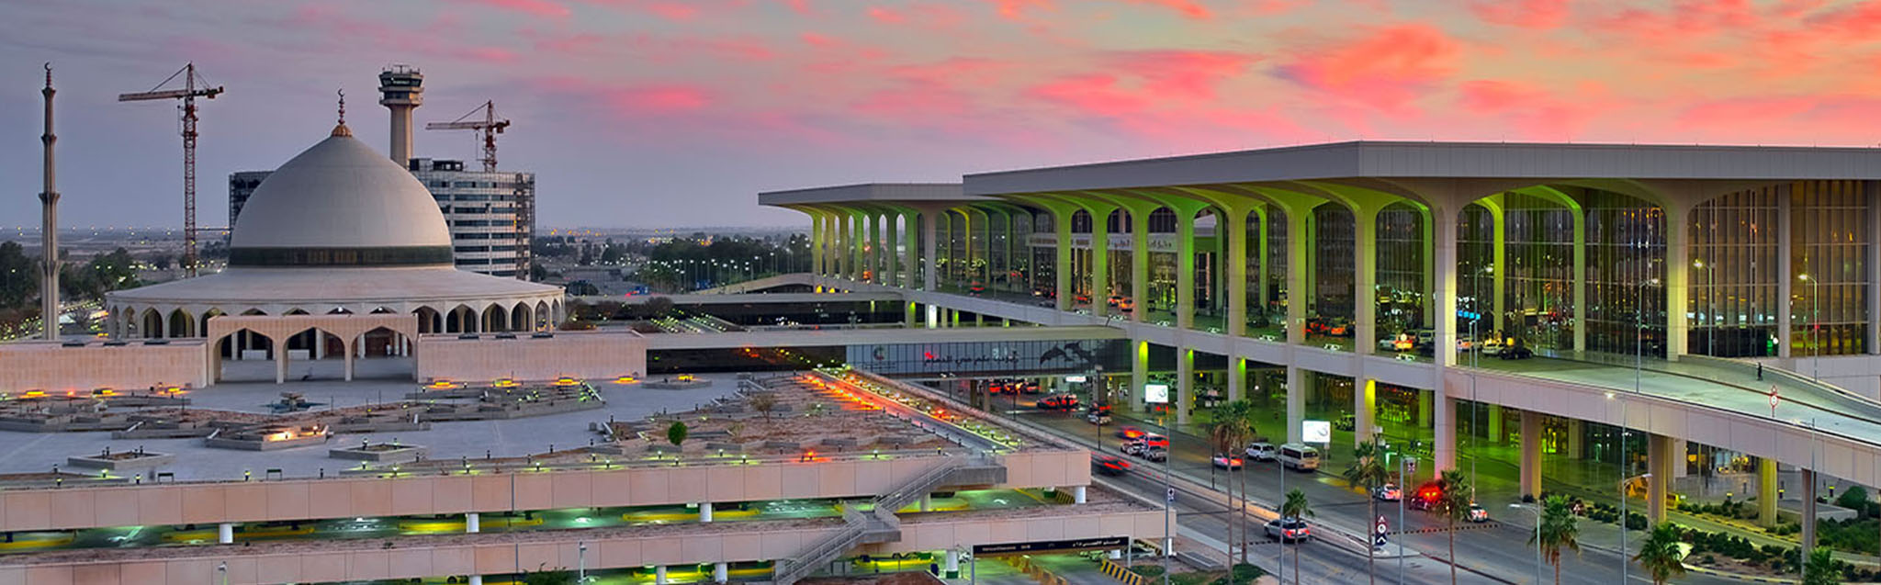
World’s Largest by Area
King Fahd International Airport is officially recognized as the largest airport in the world by land area, covering an enormous 780 square kilometers (301 square miles). This makes it even larger than the entire country of Bahrain, which highlights just how vast the airport truly is.
The massive area of the airport includes runways, passenger terminals, service buildings, roads, and large unused portions of land that are kept for future expansion.
The spacious design of King Fahd International Airport reflects Saudi Arabia’s forward-thinking approach, ensuring that it will continue to grow and adapt as global air travel increases in the future.

Slide 5
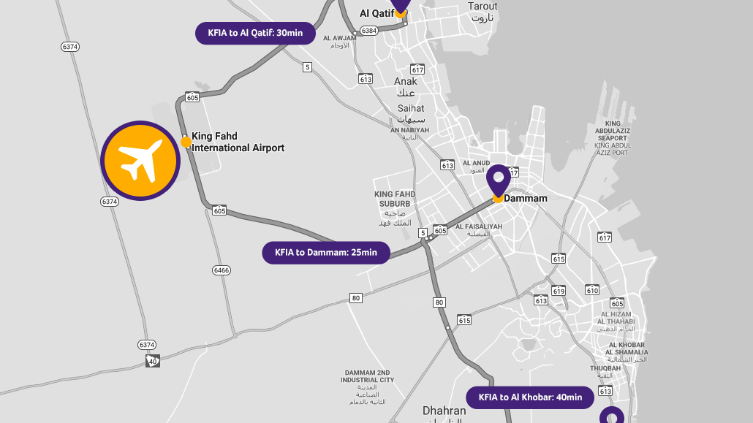
Location and Connectivity
King Fahd International Airport is located approximately 20 kilometers northwest of Dammam, in the Eastern Province of Saudi Arabia.
It serves major cities including Dammam, Dhahran, Al Khobar, and Jubail, making it an important regional hub.
The airport is connected via modern highways and road networks, ensuring quick and easy access to all terminals.
Its location supports efficient cargo transport, linking industrial areas, oil companies, and commercial centers to domestic and international destinations.
KFIA’s connectivity makes it a key player in the movement of passengers and goods throughout Saudi Arabia.

Slide 6
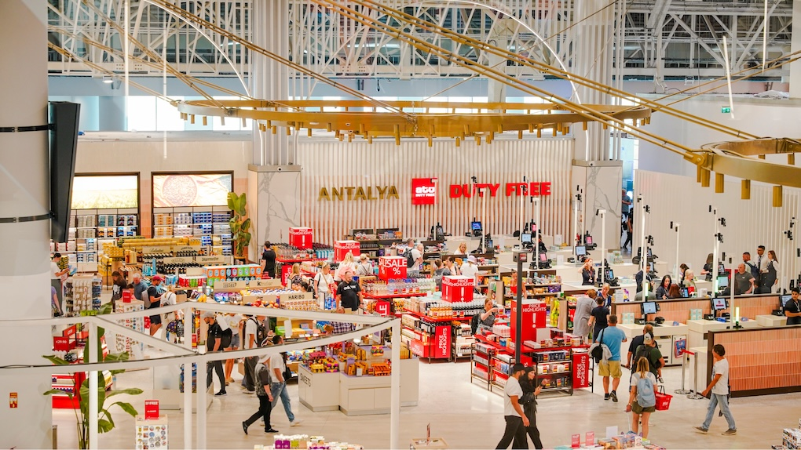
Facilities and Terminals
King Fahd International Airport has three main terminals:
Main Passenger Terminal – handles domestic and international flights.
Royal Terminal – reserved for the Saudi royal family, VIPs, and government officials.
Aramco Terminal – used exclusively by Saudi Aramco employees.
The airport includes modern lounges, restaurants, cafes, and shopping areas for travelers’ convenience.
It features a multi-level parking system capable of accommodating thousands of vehicles.
Efficient road networks and transportation services connect the terminals for smooth passenger movement.
The airport is equipped with advanced security, baggage handling, and passenger facilities to ensure a comfortable travel experience.

Slide 7
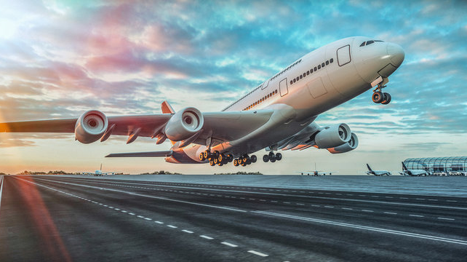
Airlines and Operations
King Fahd International Airport serves as a major hub for Saudia (Saudi Arabian Airlines) and Flynas.
The airport offers flights to numerous international destinations, including Dubai, London, Riyadh, and Jeddah.
It handles millions of passengers annually, making it one of the busiest airports in Saudi Arabia.
KFIA also supports cargo operations, linking industrial areas and commercial centers to global markets.
The airport ensures efficient flight scheduling, advanced air traffic management, and modern passenger services for a smooth travel experience.

Slide 8


